Slide 1
Hexaplant
Jonas, Rafa, Alex, Timon
Notes:
Alex

Slide 2
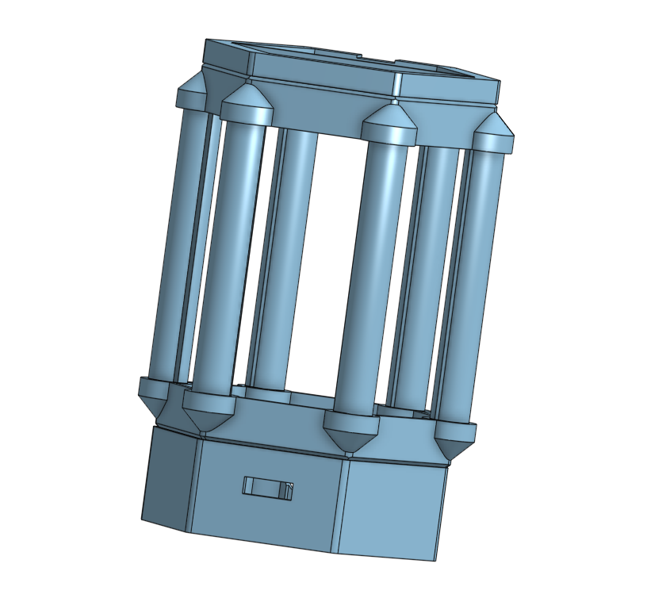
Modern Design
Modular
Simple parts
Easy to assemble
Notes:
Alex

Slide 3
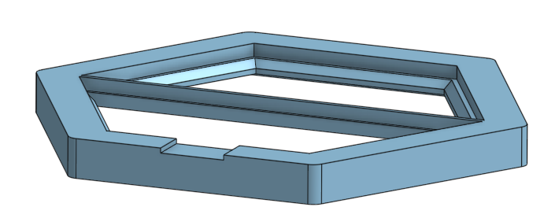
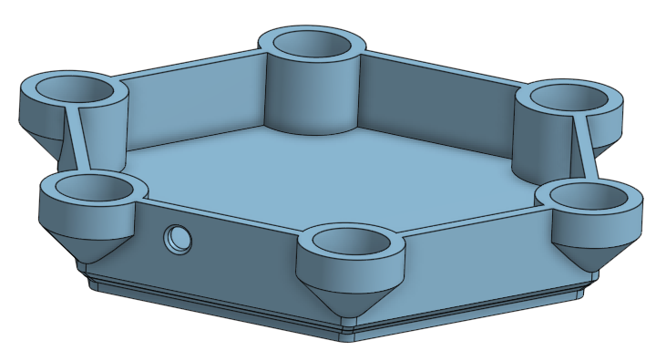
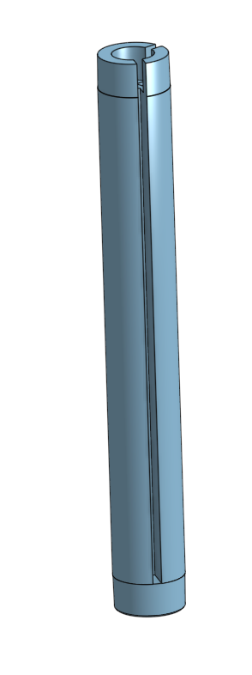
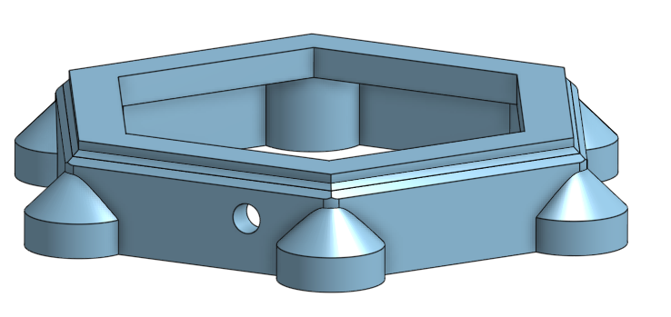
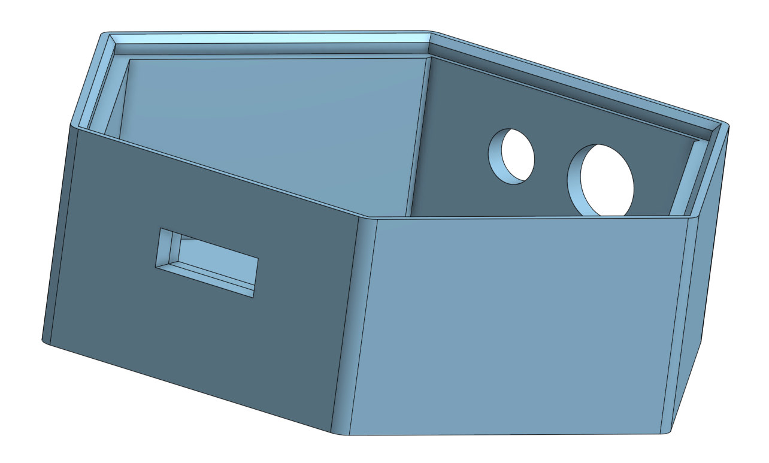
The Parts - 5 Pieces
Plant Base
Window Holder
Base
Pillar Top
Pillar
Notes:
Timon

Slide 4
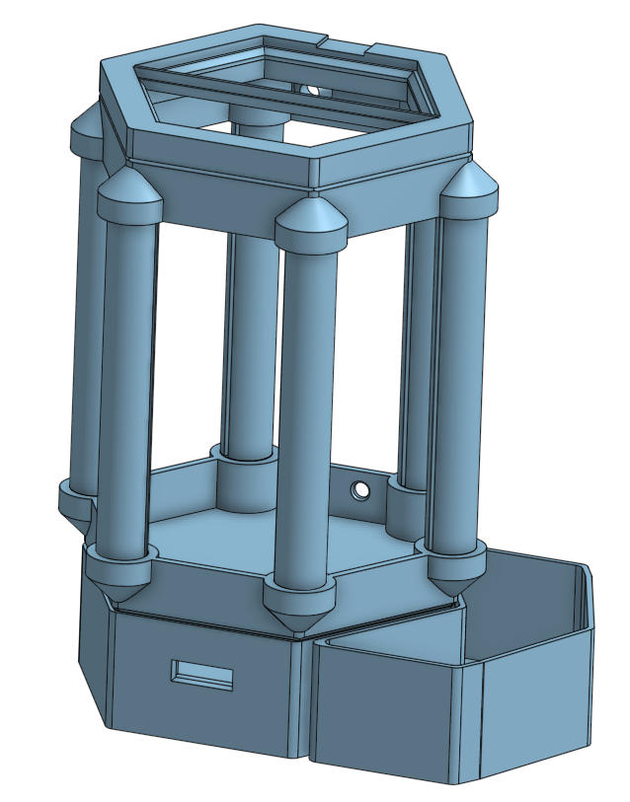
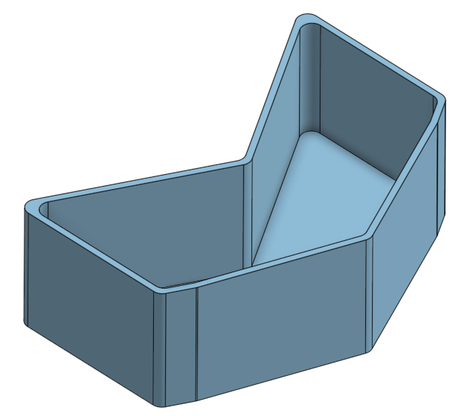
Extension
Provided Water tank.
Other Extensions possible
that fit perfectly on the shape.
Notes:
Timon

Slide 5
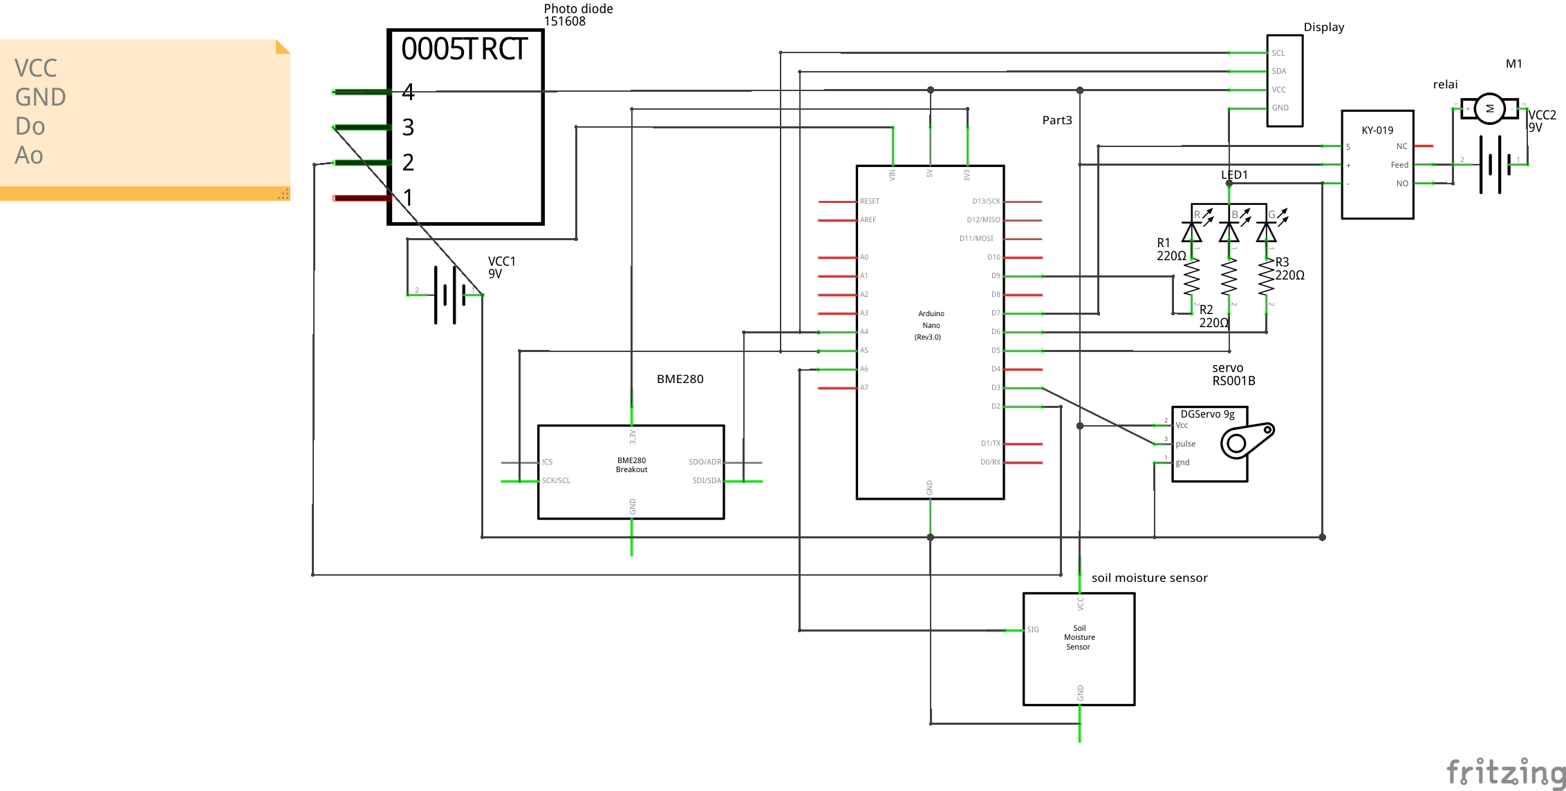
Electronics
Notes:
Jonas

Slide 6
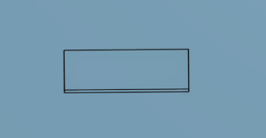
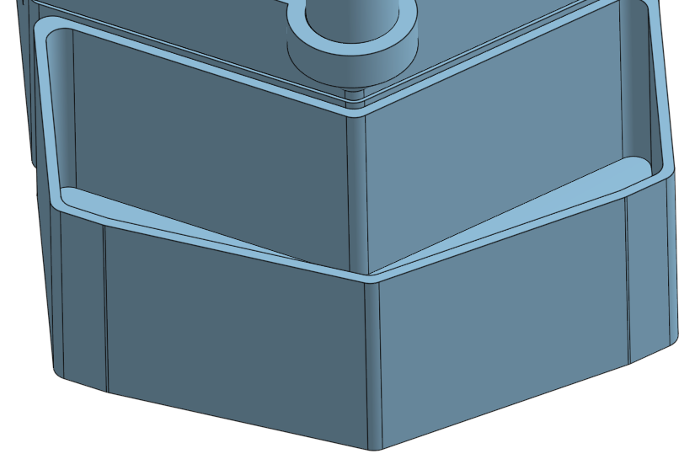
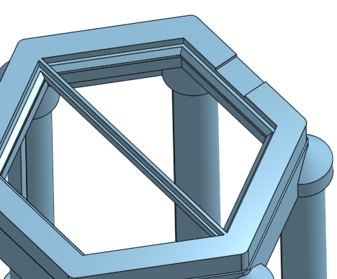
Features
Display with window
Temperature
Humility
Soil messurement
Light level
Pump
Automatic watering system
Water tank
Window
Opens if to hot
Closes if to cold
Notes:
Jonas

Slide 7
Assembly
Print all required parts
Assemble structure and wire components (see README.md → Assembly → Step By Step)
Flash code and verify functionality
Prepare and insert glass panels
Complete final assembly
You can find the instructions at https://github.com/Monstroxx/greenhouse
Notes:
Rafa

Slide 8
In Action
See it in real live
Notes:
Rafa

